Slide 1

Principal Components of Attractiveness
Machine Learning Applications for Image Processing
Zihan-Wes-Tumi
Image: Shudu Gram, Instagram’s first digital supermodel, computer generated by British photographer Cameron-James Wilson, a 28-year old white man.
IMAGE FEATURES SHUDU, A MACHINE LEARNING GENERATED INSTAGRAM MODEL

Slide 2
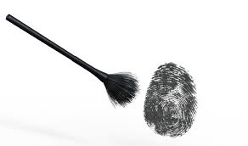
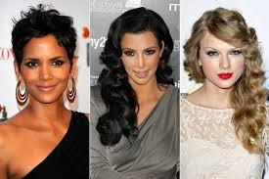
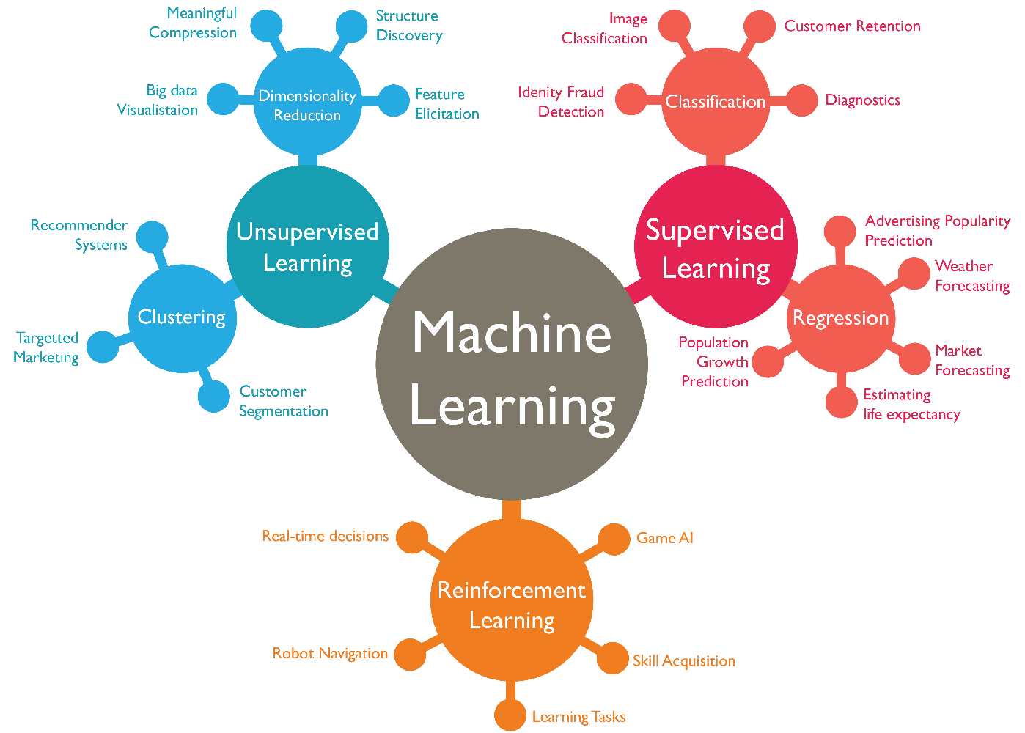
INQUIRY – HYPOTHESIS - METHODS
INQUIRY
HYPOTHESIS
METHODS
WHAT ATTRIBUTES MAKE CELEBRITIES ATTRACTIVE?
HOLLYWOOD HAS AN “ATTRACTIVE” LOOK THAT CAN BE DECOMPOSED INTO PRINCIPAL COMPONNENTS
TEAM WILL REVIEW 3 DIFFERENT MACHINE LEARNING METHODS TO EXPLORE THE HYPOTHESIS
FACIAL RECOGNITION
DECISION TREES
EIGEN VECTORS W/PCA
Zihan-Wes-Tumi

Slide 3
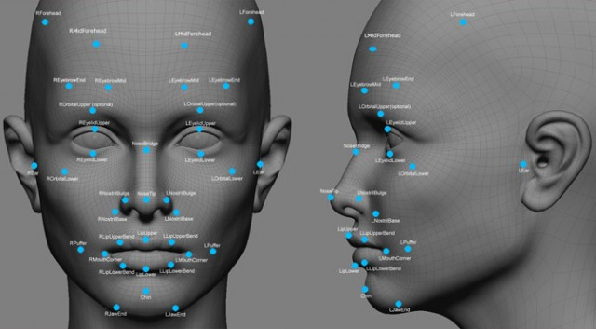
MACHINE LEARNING FACIAL RECOGNITION & MERGING
Presenter - Zihan
ZIHAN
Zihan-Wes-Tumi

Slide 4
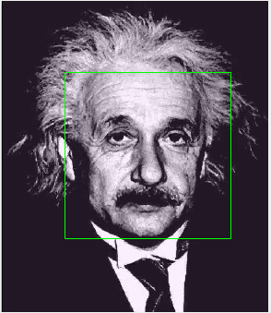
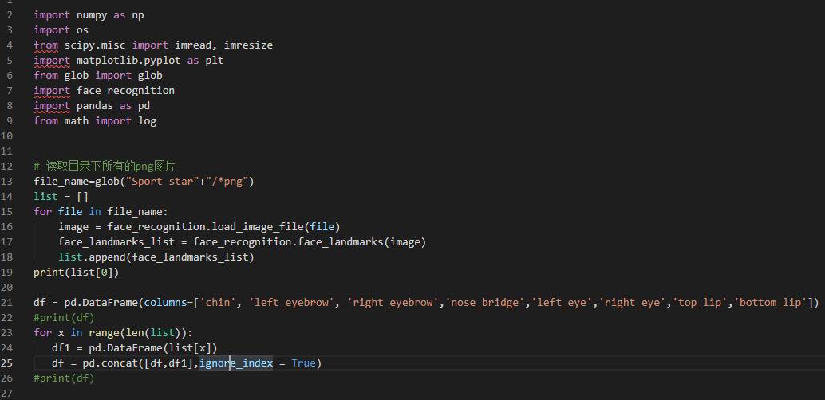
Face recognition and detection
1. Algorithm
Viola-Jones algorithm
2.Stack
Python OpenCV
MATLAB
Zihan-Wes-Tumi

Slide 5
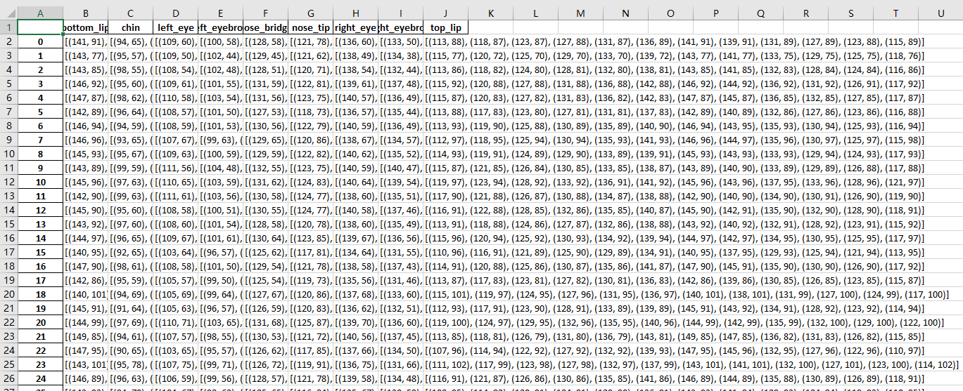
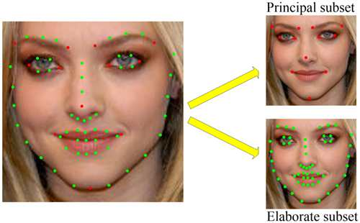
Facial Landmarks
Facial landmarks are prominent features that serve as anchor points on a face graph to facilitate various applications, including: animation, facial recognition, gaze detection, face tracking, expression recognition, gesture understanding and more.”
https://pdfs.semanticscholar.org/6a7e/464464f70afea78552c8386f4d2763ea1d9c.pdf
Zihan-Wes-Tumi

Slide 6
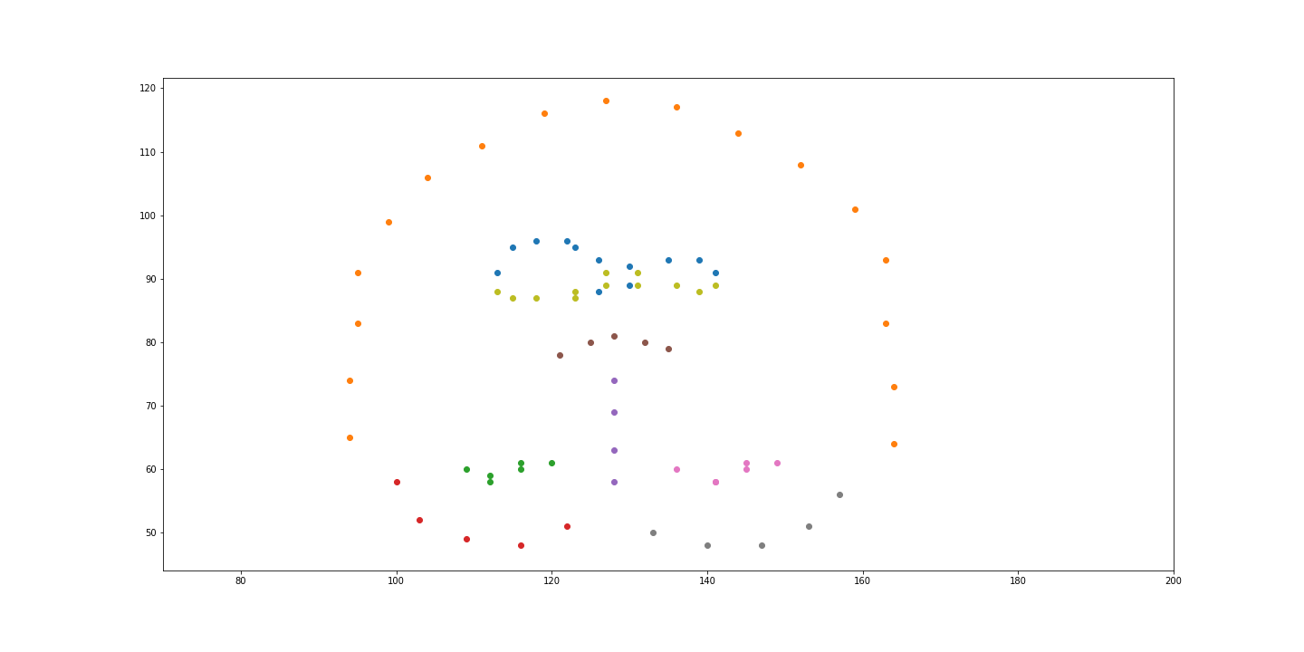
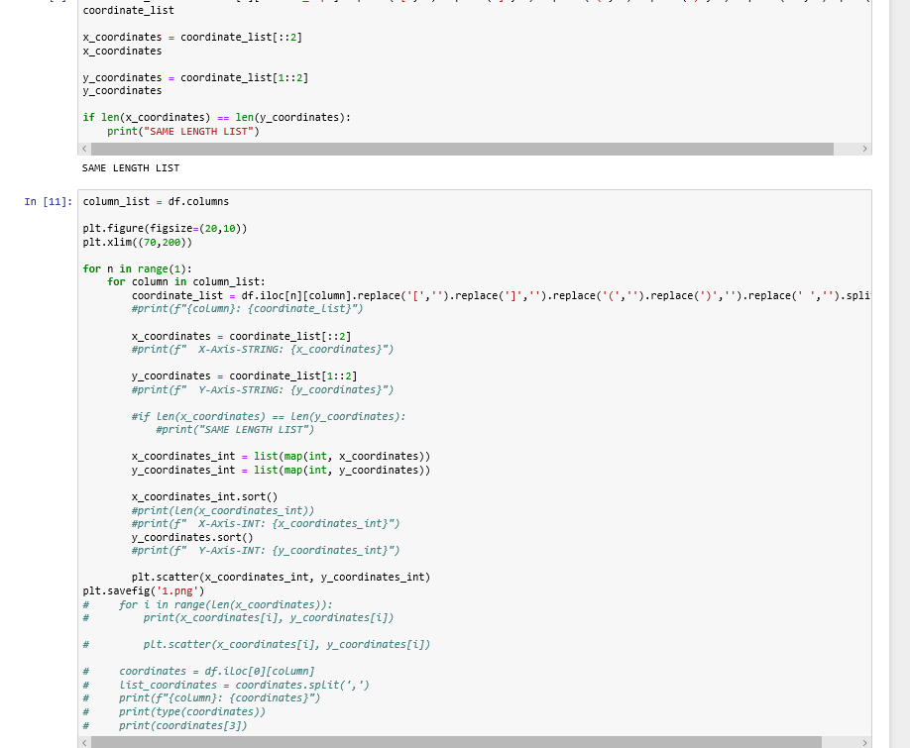
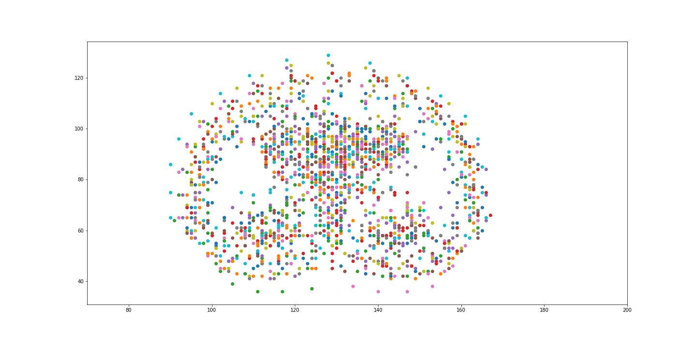
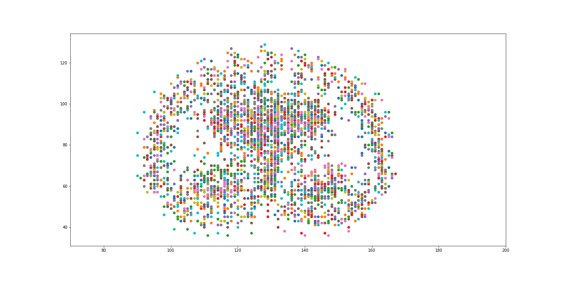
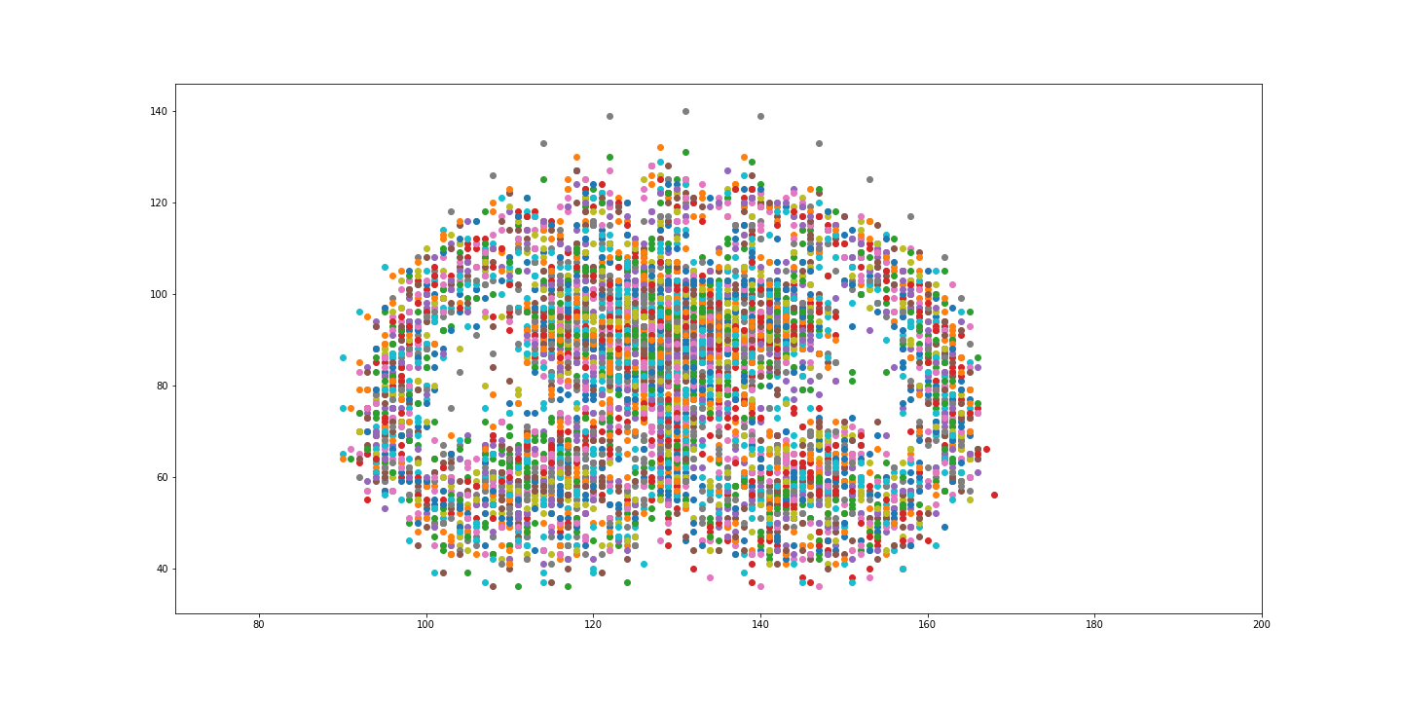
Face merge (part1)
Facial landmarks were used by Matplotlib to align key points on the face prior to merging images
Zihan-Wes-Tumi

Slide 7
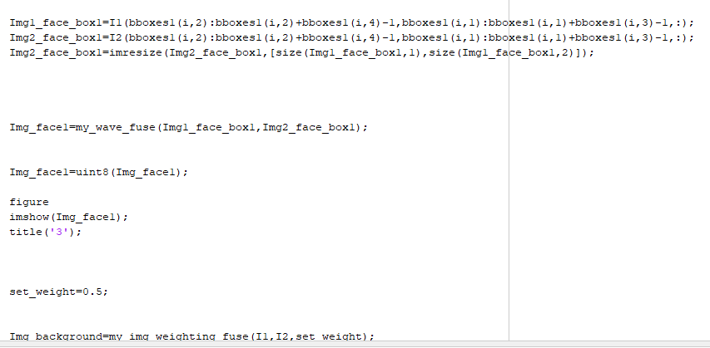
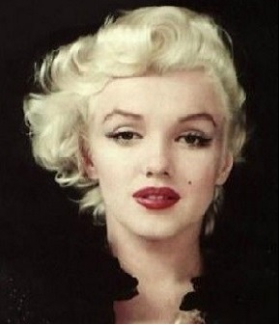
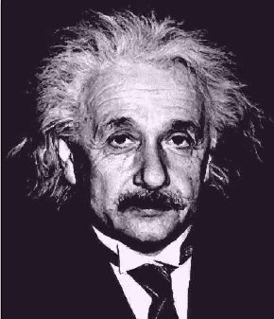
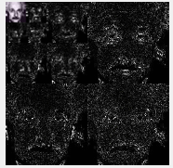
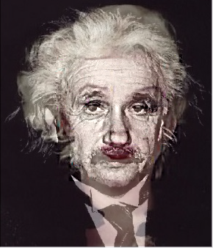
Face merge (part2)
Algorithm
Gaussian pyramid
Approach
MATLAB
Zihan-Wes-Tumi

Slide 8
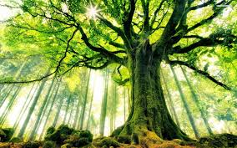
MACHINE LEARNING DECISION TREES
WES
Zihan-Wes-Tumi

Slide 9
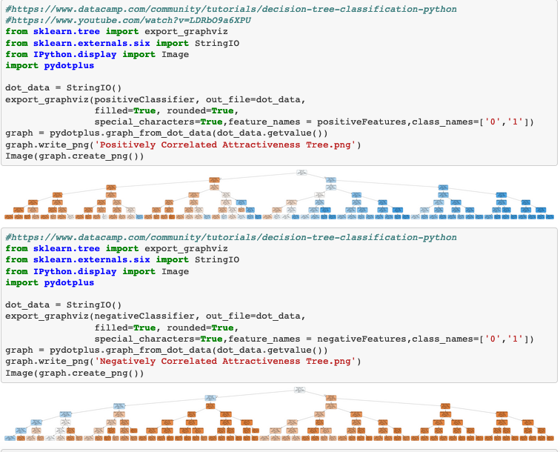
Decision Tree – Supervised Machine Learning
A decision tree is a type of supervised learning algorithm that can be used in both regression and classification problems. It works for both categorical and continuous input and output variables.
Algorithm
Decision Tree
Stack
Python-SKLearn
Zihan-Wes-Tumi

Slide 10
Decision Tree – Training & Testing Scores
Youth, arched eyebrows and a pointy nose had the highest positive impact on perception of attractiveness, while big noses, chubbiness and double chins were the attributes with the highest negative correlations.
Attractiveness Correlations
Positive | % Explained | Negative | % Explained
Young | 38.77% | Big Nose | -27.71%
Arched Eyebrows | 25.06% | Chubby | -23.71%
Pointy nose | 22.83% | Double Chin | -20.9%
Oval Face | 19.39% | Receding Hairline | -17.87%
Rosy Cheeks | 16.39% | Bags under eyes | -17.85%
High Cheekbones | 14.91% | Side burns | -10.02%
Positively Correlated Features
Positively Correlated Features Training Score: 0.7126251449913211
Positively Correlated Features Testing Score: 0.7099210266535044
Negatively Correlated Features
Negatively Correlated Features Training Score: 0.6542090672019348
Negatively Correlated Features Testing Score: 0.6515918065153011
Zihan-Wes-Tumi

Slide 11
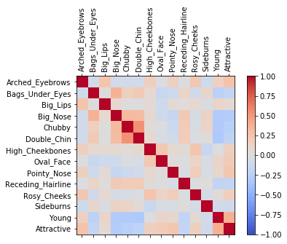
Gini Impurity & Information Gain
Positively Correlated Features
Young Provides the best Information Gain
Gini Impurity Score - 0.5
Negatively Correlated Features
Big Nose Provides the best Information Gain
Gini Impurity Score – 0.5
Chubby is a close 2nd with a impurity score of 0.484
Zihan-Wes-Tumi

Slide 12
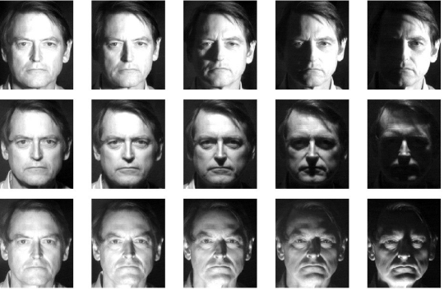
MACHINE LEARNING EIGEN FACES w/PCA
TUMI
Zihan-Wes-Tumi

Slide 13
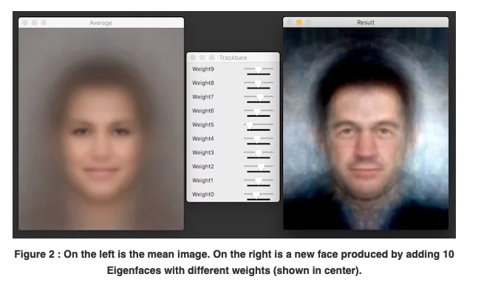
Eigen Faces - Principal Component Analysis(PCA) Unsupervised Machine Learning algorithm
Algorithm
Eigen Vectors with Principal Component Analysis - Reduce variables/attributes required to distinguish faces while preserving variation and generates new faces by manipulating principal components
Stack
Python OpenCV
Matplotlib
Sklearn/decomposition
NumPy
Pillow
Source: https://www.learnopencv.com/eigenface-using-opencv-c-python/
Zihan-Wes-Tumi

Slide 14
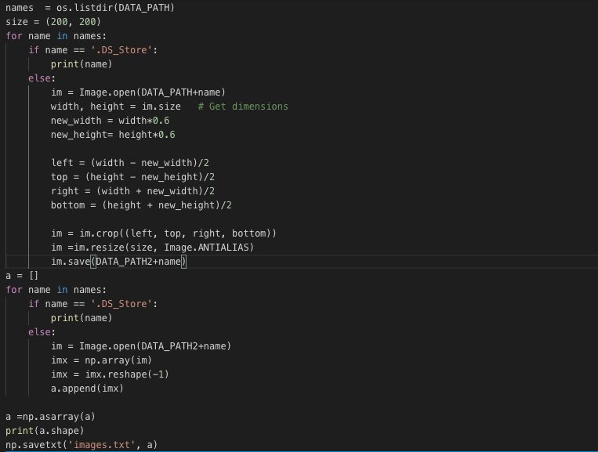
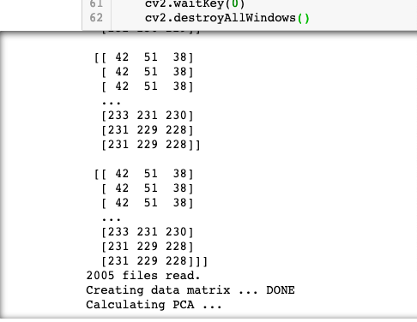
IMAGE TRANSFORMATION: PYTHON-OPENCV
2000 Images were converted to digital data matrix using OpenCV, so they could be statistically analyzed
Zihan-Wes-Tumi

Slide 15
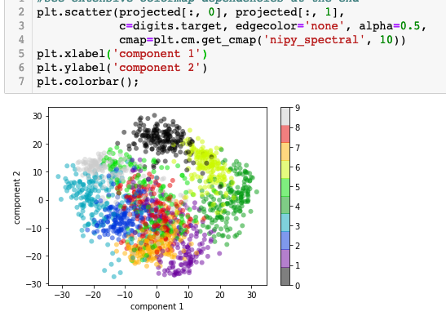
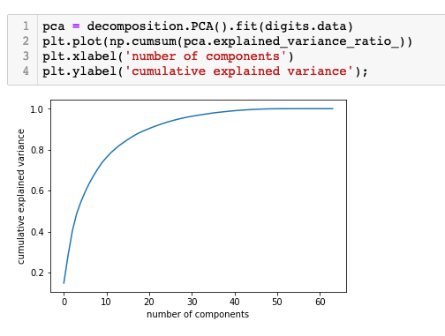
Principal Component Analysis
PCA blindly(unsupervised) maximizes variance explained in 2 dimensions
Model approaches 90% variance explained with 10 components/ attributes
Zihan-Wes-Tumi

Slide 16
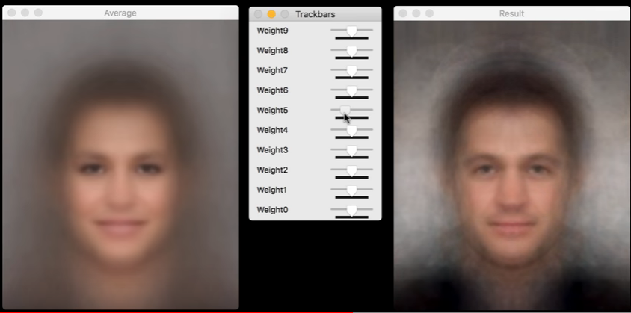
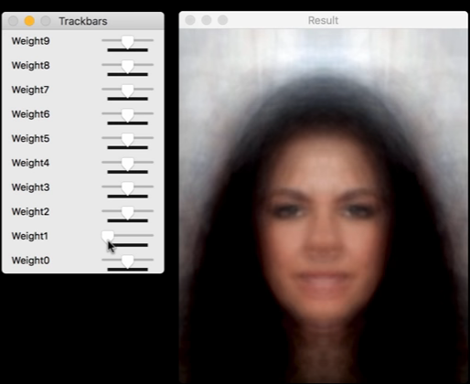
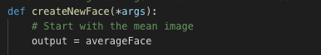

EIGEN FACE LEARNING AND PROJECTIONS
MEAN EIGEN FACE
“ATTRACTIVE” MALE PROJECTION
“ATTRACTIVE” FEMALE PROJECTION
Zihan-Wes-Tumi

Slide 17

Summary
Each machine learning algorithm taught us something different about the drivers of attractiveness.
As our dataset increased in size so too did the ability for the algorithms to explain variance and predict similar results.
Two or three machine learning algorithms are better than one!

Slide 18

Thank You
Zihan – Wes - Tumi

